Slide 1
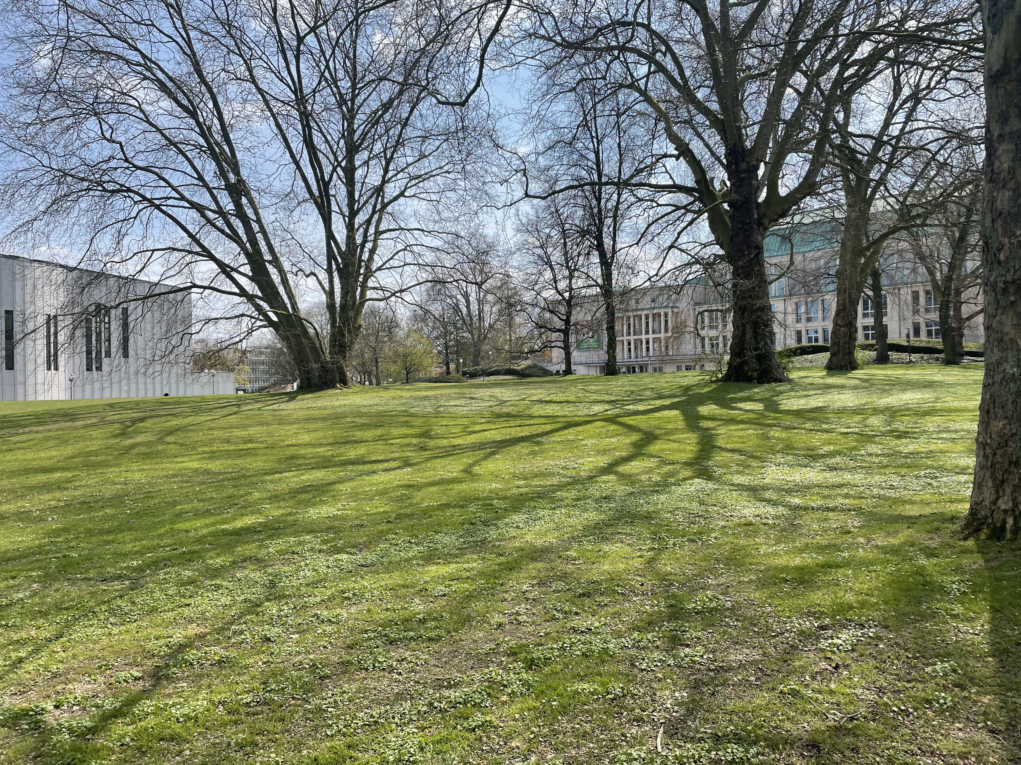

JAPANESE-GERMAN REAL ESTATE BRIDGE
Regional Investment Diversification in Times of Global Crisis - Example COVID-19 Pandemic
March 15, 2022

Slide 2
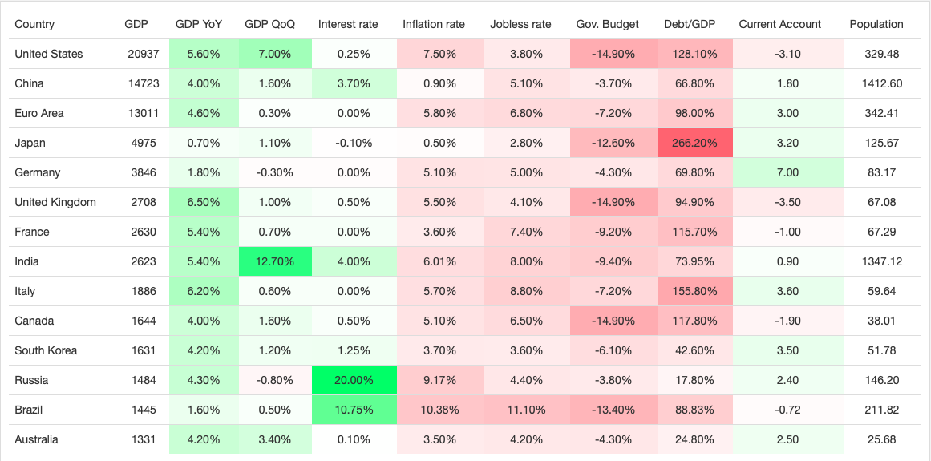
World Economic Figures as of March 2022
Source: Trading Economics

Slide 3
Real Estate Sentiment and -Crisies in Germany 2008 – 2022 by Asset Class (until February 2022)
Global Crisis
Financial Markets
Curreny Troubles EURO
First Potential
War in Ukraine
First Lockdown COVID-19
Source: bulwiengesa / Deutsche Hypo – asked, how the upcoming six months compare to the past six months
3

Slide 4
German Real Estate Assets of Institutional Investors Germany, 2021, Total of 585 Billion Euro
»
31 %
of Germany‘s institutional real estate is held by foreign investors
Source: BVI, BAFin, BdL, Deutsche Bundesbank-Kapitalmarktstatistik, survey bulwiengesa AG

Slide 5
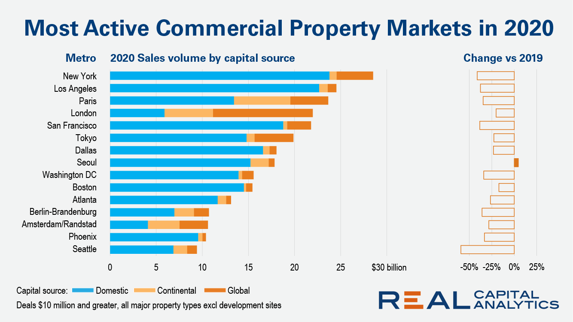
Global Property Markets in Comparison
Source: MSCI, Real Capital Analytics

Slide 6
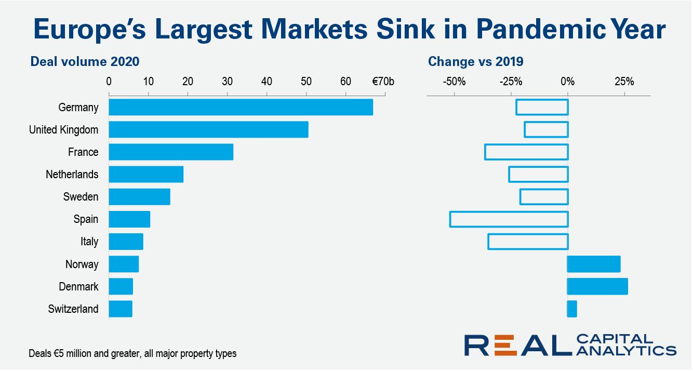
2020 Transaction Volumes in European Markets
Source: MSCI, Real Capital Analytics

Slide 7
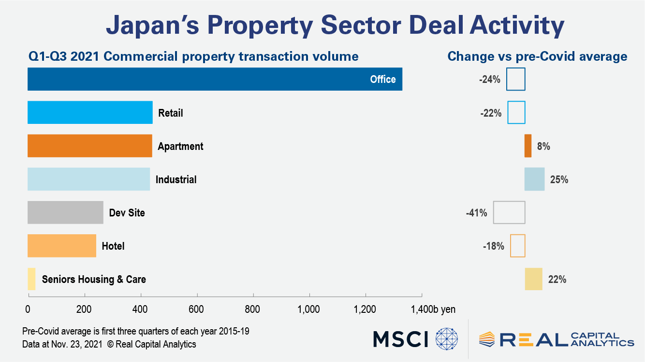
The Japanese Property Market in 2021
Source: MSCI, Real Capital Analytics

Slide 8
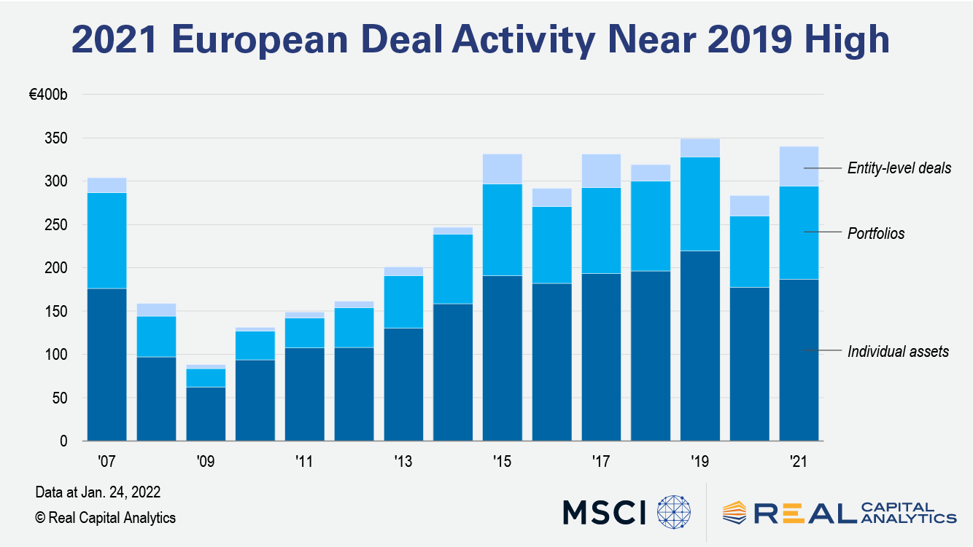
Investment Activities in the European Property Market
Source: MSCI, Real Capital Analytics

Slide 9
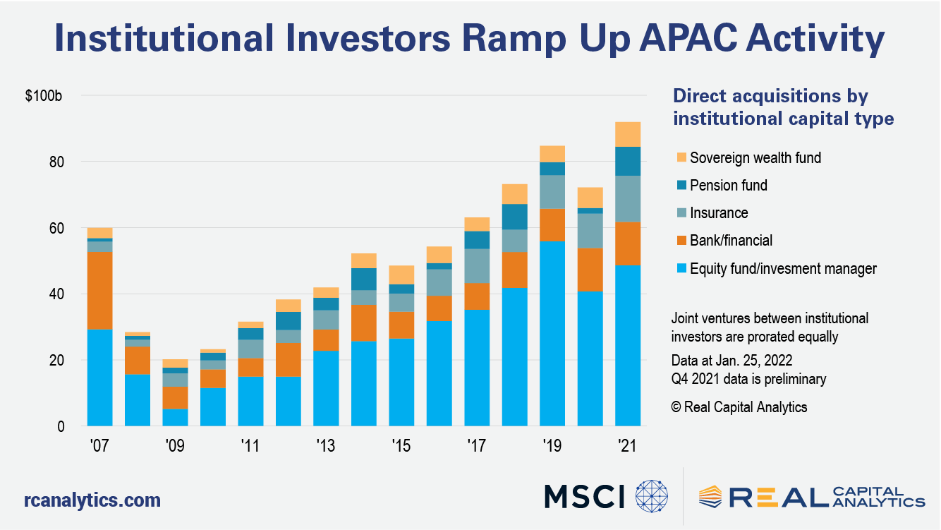
Direct Investment by institutional Capital in the APAC region
Source: MSCI, Real Capital Analytics

